Slide 1
Contact Manager
Team:
Jessica Wingert
Hunter Pierce
Bhavika Boga
Edward Plummer
Taylor Knight
Bailey Muckel

Slide 2
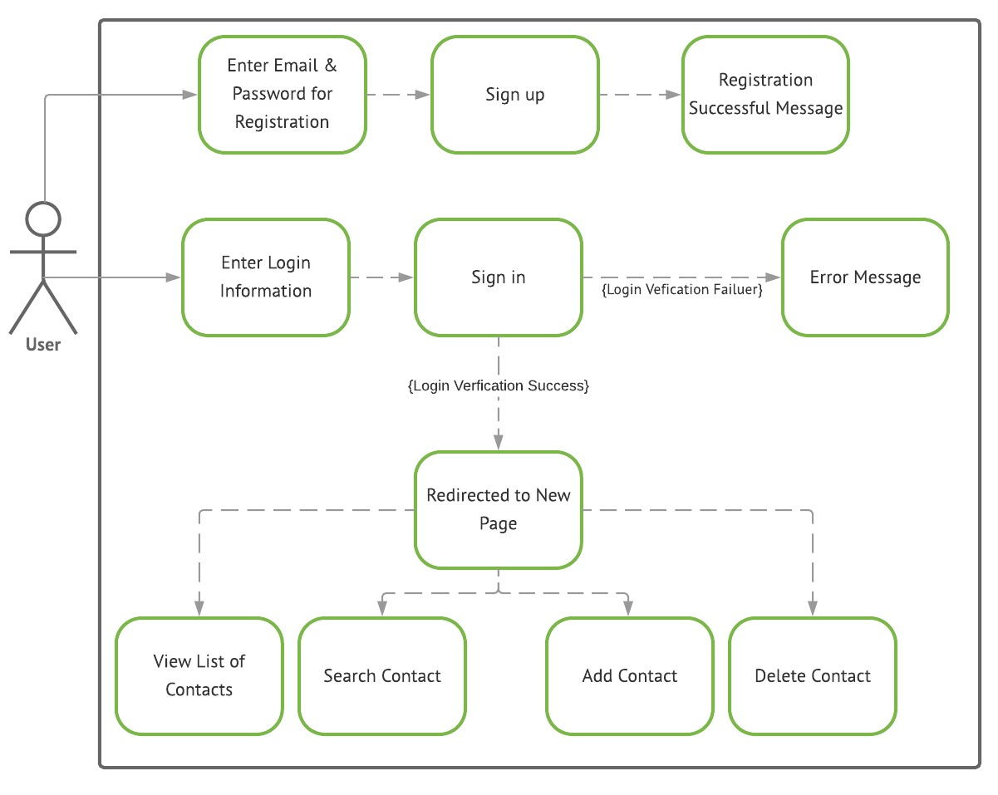
Use Case Diagram

Slide 3
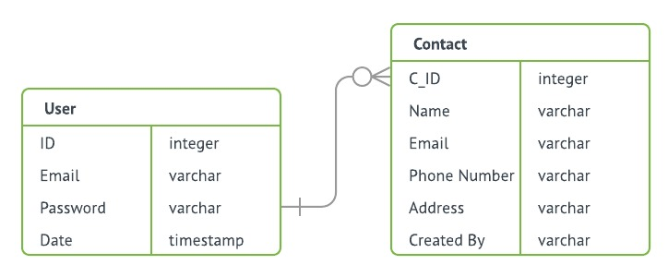
ER Diagram

Slide 4
Software Used
Bootstrap
PhpMyAdmin
mySQL
Apache

Slide 5
Demo
http://hunter-pierce.com/

Slide 6
Q & A

